Slide 1

Ramblr Making Reassembly Great Again
Ruoyu “Fish” Wang, Yan Shoshitaishvili, Antonio Bianchi, Aravind Machiry, John Grosen, Paul Grosen, Christopher Kruegel, Giovanni Vigna

Slide 2
Motivation

Slide 3
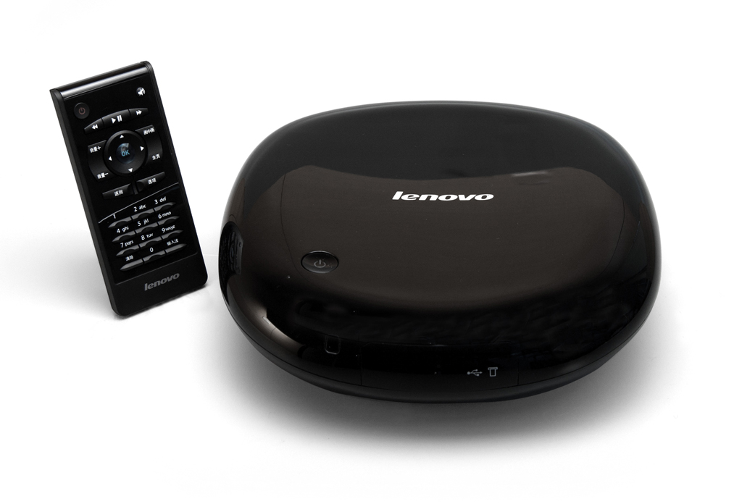


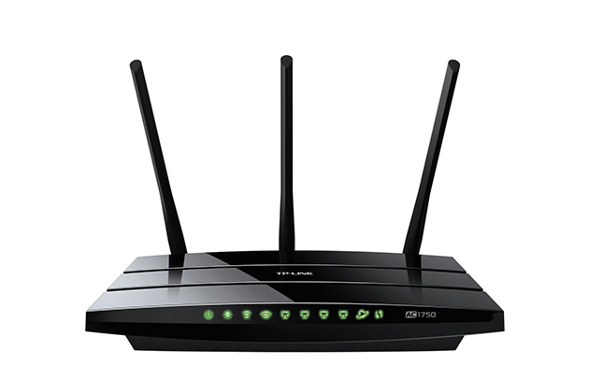
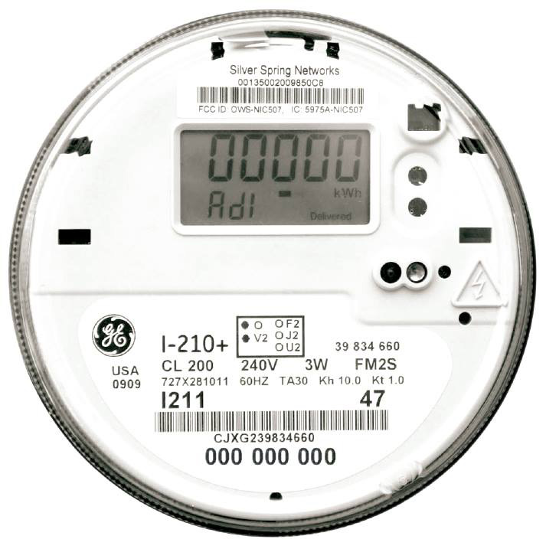

Slide 4
Available Solutions
Pure Static
Dynamic
Static + Dynamic

Slide 5
What is Binary Reassembly?

Slide 6

 | .text
400100 | mov [6000a0], eax
400105 | jmp 0x40020d
 | ...
40020d | mov [6000a4], 1
 | .data
6000a0 | .long 0xc0debeef
6000a4 | .long 0x0
Disassemble

Slide 7
 | .text
 | mov [data_0], eax
 | jmp target
 | ...
target | mov [data_1], 1
 | .data
data_0 | .long 0xc0debeef
data_1 | .long 0x0
Disassemble

Slide 8

 | .text
400100 | mov [6000a0], eax
400105 | jmp 40020d
 | ...
Patch & Assemble
40020d | CRASH!
Disassemble
40020d | mov [6000a4], 1
 | .data
40020f
6000a0 | .long 0xc0debeef
6000a4 | .long 0x0
6000a0 | “cat\x00”
6000a4
6000a8
Non-relocatable Assembly

Slide 9

 | .text
 | mov [data_0], eax
 | jmp target
 | ...
 | CRASH!
target | mov [data_1], 1
 | .data
new | “cat\x00”
data_0 | .long 0xc0debeef
data_1 | .long 0x0
 | .text
 | mov [data_0], eax
 | jmp target
 | ...
 | mov [data_1], 1
 | .data
data_0 | .long 0xc0debeef
data_1 | .long 0x0
Patch & Assemble
Disassemble
Relocatable Assembly

Slide 10
0x80486f0
.text
.rodata
.data
.bss
Code regions
0x804d000
0x804d200
Data regions
0x804e000

Slide 11
0x80486f0
.text
.rodata
.data
.bss
.text:
80488e3: push ebp
80488e4: mov ebp, esp
80488e6: sub esp, 0x48
80488e9: mov DWORD PTR [ebp-0x10], 0x0
80488f0: mov DWORD PTR [ebp-0xc], 0x0
80488f7: mov DWORD PTR [ebp-0xc], 0x80540a0
80488fe: mov eax, 0xfb7
8048903: mov WORD PTR [ebp-0x10], ax
8048907: mov eax, ds:0x805be60
804890c: test eax, eax
804890e: jne 0x804895b
8048910: mov eax, ds:0x805be5c
...
.data:
804d538: ec 8e 04 08
804d53c: 05 8f 04 08
804d540: 1e 8f 04 08
0x48
0x804d000
0x0
0x0
0x80540a0
0x804d200
0xfb7
0x805be60
0x804e000
0x804895b
0x805be5c
0x8048eec
Uroboros
0x8048f05
0x8048f1e
USENIX Sec ‘15

Slide 12
Problems

Slide 13




False Positives
False Negatives
Thanks xkcd :-)

Slide 14
Problem: Value Collisions
False Positives
8060080 .db 3d
8060081 .db ec
8060082 .db 04
8060083 .db 08
/* stored at 0x8060080 */
static float a = 4e-34;
Byte Representation
A Floating-point Variable a
8060080 label_804ec3d
Interpreted as a Pointer

Slide 15
Problem: Compiler Optimization
False Negatives
int ctrs[2] = {0};
int main()
{
int input = getchar();
switch (input – 'A')
{
case 0:
ctrs[input – 'A']++;
break;
...
}
}
int ctrs[2] = {0};
int main()
{
int input = getchar();
switch (input – 'A')
{
case 0:
ctrs[input – 'A']++;
break;
...
}
}
A code snippet allows constant folding

Slide 16
Problem: Compiler Optimization
False Negatives
0x804a034 – ‘A’ * sizeof(int) = 0x8049f30
int ctrs[2] = {0};
int main()
{
int input = getchar();
switch (input – 'A')
{
case 0:
ctrs[input – 'A']++;
break;
...
}
}
; Assuming ctrs is stored at 0x804a034
; eax holds the input character
; ctrs[input – 'A']++;
add 0x8049f30[eax * 4], 1
...
.bss
804a034: ctrs[0]
804a038: ctrs[1]
0x8049f30 does not belong to any section
A code snippet allows constant folding
Compiled in Clang with –O1

Slide 17
Our Approach

Slide 18
Naïve Strategy
False Positives
False Negatives
Heuristics

Slide 19
Ramblr
Heuristics
False Positives
False Negatives
Program Analysis

Slide 20
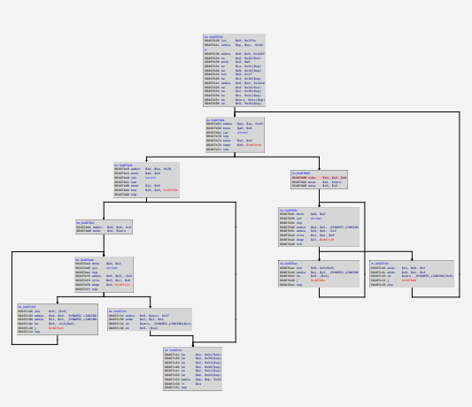
Pipeline
0x804850b | Pointer
0xa | Integer
0xdc5 | Integer
63 61 74 00 | String
0x80484a2 | Pointer
0x804840b | Pointer
0xa0000 | Integer
push offset label_34
push offset label_35
cmp eax, ecx
jne label_42
.label_42:
mov eax, 0x12fa9e5
...
Symbolization
&
Reassembly
CFG Recovery
Content Classification

Slide 21
Pipeline
0x804850b | Pointer
0xa | Integer
0xdc5 | Integer
63 61 74 00 | String
0x80484a2 | Pointer
0x804840b | Pointer
0xa0000 | Integer
push offset label_34
push offset label_35
cmp eax, ecx
jne label_42
.label_42:
mov eax, 0x12fa9e5
...
Symbolization
&
Reassembly
CFG Recovery
Content Classification

Slide 22


CFG Recovery
31 ed 5e 89 e1 83 e4 f0 50 54 52 68 00 25 05 08
0x80486f0:
xor ebp, ebp
pop esi
mov ecx, esp
and esp, 0xfffffff0
push eax
push esp
push edx
...
Recursive Disassembly
Iterative Refinement

Slide 23
Content Classification
((value * 42) ^ 5) / 3
*((int*)0x8045010)
value * 42
5
.text
.rodata
.data
.bss
3
xor
*ptr
/
result
A Typical Pointer
A Typical Value

Slide 24
Content Classification
Type Category | Examples
Primitive types | Pointers, shorts, DWORDs, QWORDs, Floating-point values, etc.
Strings | Null-terminated ASCII strings, Null-terminated UTF-16 strings
Jump tables | A list of jump targets
Arrays of primitive types | An array of pointers, a sequence of integers
Data Types that Ramblr Recognizes

Slide 25
Content Classification
MOVe Scalar Double-precision floating-point value
Two floating-points
804d750 | Floating point integer
804d758 | Floating point integer
movsd xmm0, ds:0x804d750
movsd xmm1, ds:0x804d758
Recognizing Types during CFG Recovery

Slide 26
Content Classification
chr = _getch();
switch (i)
{
case 1:
a += 2; break;
case 2:
b += 4; break;
case 3:
c += 6; break;
default:
a = 0; break;
}
switch (i)
{
case 1:
...
case 2:
...
case 3:
...
default:
...
}
Slicing
Recognizing Types with Slicing & VSA

Slide 27
Content Classification
if(i > 3)
i = [0, 2] with a stride of 1
VSA
A jump table of 3 entries
table[0] | Pointer, jump target
table[1] | Pointer, jump target
table[2] | Pointer, jump target
jmp table[i * 4]
Quit switch
Recognizing Types with Slicing & VSA

Slide 28
Base Pointer Reattribution
False Negatives
int ctrs[2] = {0};
int main()
{
int input = getchar();
switch (input – 'A')
{
case 0:
ctrs[input – 'A']++;
break;
...
}
}
; Assuming ctrs is stored at 0x804a034
; eax holds the input character
; ctrs[input – 'A']++;
add 0x8049f30[eax * 4], 1
...
.bss
804a034: ctrs[0]
804a038: ctrs[1]
0x8049f30 does not belong to any section
A code snippet allows constant folding
Compiled in Clang with –O1

Slide 29
Base Pointer Reattribution
False Negatives
Belongs to .bss
; Assuming ctrs is stored at 0x804a034
; eax holds the input character
; ctrs[input – 'A']++;
add 0x8049f30[eax * 4], 1
...
.bss
804a034: ctrs[0]
804a038: ctrs[1]
0x8049f30
‘A’ * 4
Constant un-folding
add
0x804a034
0x8049f30 does not belong to any section
The Slicing Result
Compiled in Clang with –O1

Slide 30

Safety Heuristics: Data Consumer Check
DWORD PTR [0x8045000]
DWORD PTR [0x8045f08]
xor
*(the_result)
I GIVE UP
Unusual Behaviors Triggering the Opt-out Rule

Slide 31
Symbolization & Reassembly
0x400010 |  | label_34
0x400020 |  | label_35
0x400a14 |  | label_42
...
0x406000 |  | data_3
push offset label_34
push offset label_35
cmp eax, ecx
jne label_42
.label_42:
mov eax, 0x12fa9e5
...
Symbolization
Assembly Generation

Slide 32
Evaluation

Slide 33
Data sets
 | Coreutils 8.25.55 | Binaries from CGC
Programs | 106 | 143
Compiler | CGC 5 | Clang 4.4
Optimization levels | O0/O1/O2/O3/Os/Ofast
Architectures | X86/AMD64 | X86
Test cases | Yes | Yes
Total binaries | 1272 | 725

Slide 34
Brief Results: Success Rate

Slide 35

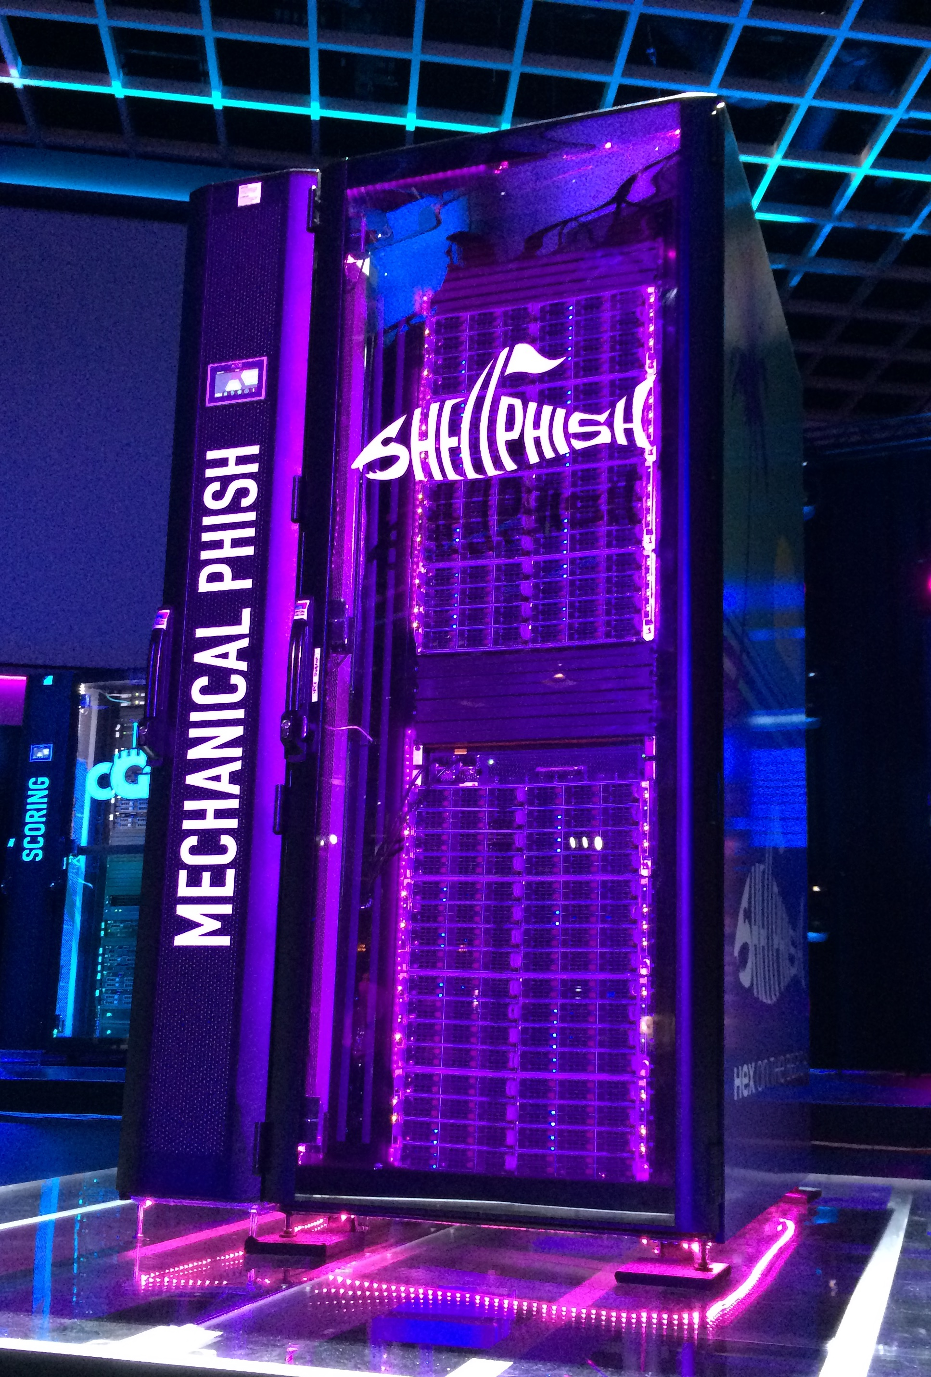


Slide 36
Ramblr is the foundation of ...
Patching Vulnerabilities
Obfuscating Control Flows
Optimizing Binaries
Hardening Binaries

Slide 37
Conclusion

Slide 38
Conclusion
Identified challenges in reassembling
Proposed a novel composition of static analysis techniques
Developed a systematic approach to reassemble stripped binaries
Ramblr is open-sourced
Extra data-sets and usable tools will be released soon

Slide 39
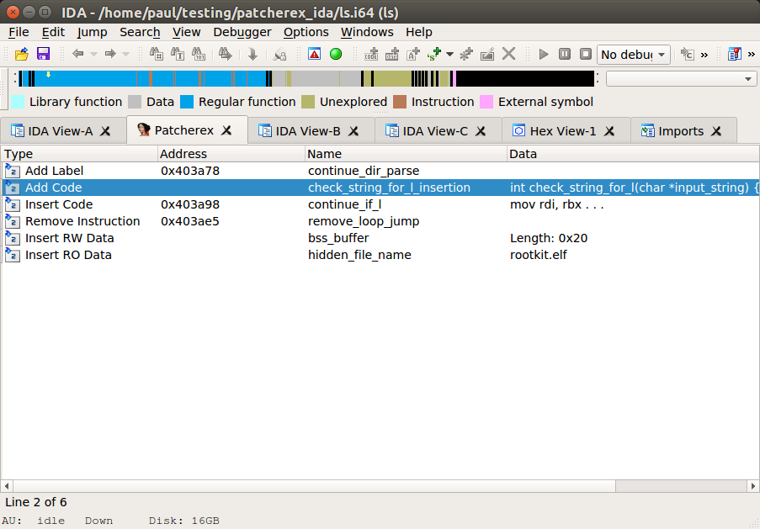
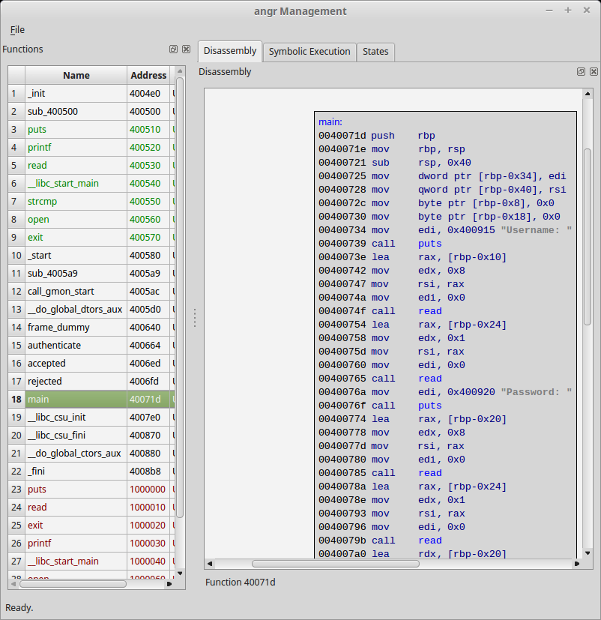
Tools
Patching support in angr Management
Ramblr IDA Plugin
Patcherex

